Slide 1
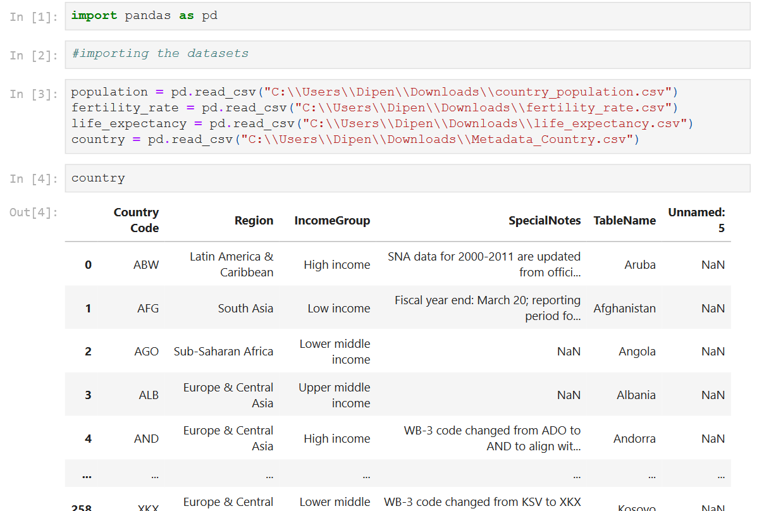
WORLD BANK DATA ANALYSIS PROJECT
Dataset Information
Life expectancy at birth: The number of years a newborn would live if the patterns of mortality at the time of birth remain the same throughout his life.
Fertility rate: Number of children a woman would give birth to during her childbearing years.
Country population: Total number of residents regardless of legal status or citizenship (midyear estimates)

Slide 2
In this project, I have done the following data processing.
Loading the datasets
Understanding the Data information of each datasets
Updating the datasets by checking null values ,removing the null values ,deleting the unnecessary columns
Melting the DataFrames
Merging DataFrames
Plotting the graph for the clear visualization
Population Trends (Years vs Population)(Line Graph)
Fertility rate distribution
Life expectancy variation
Correlation Analysis
Regional Analysis

Slide 3
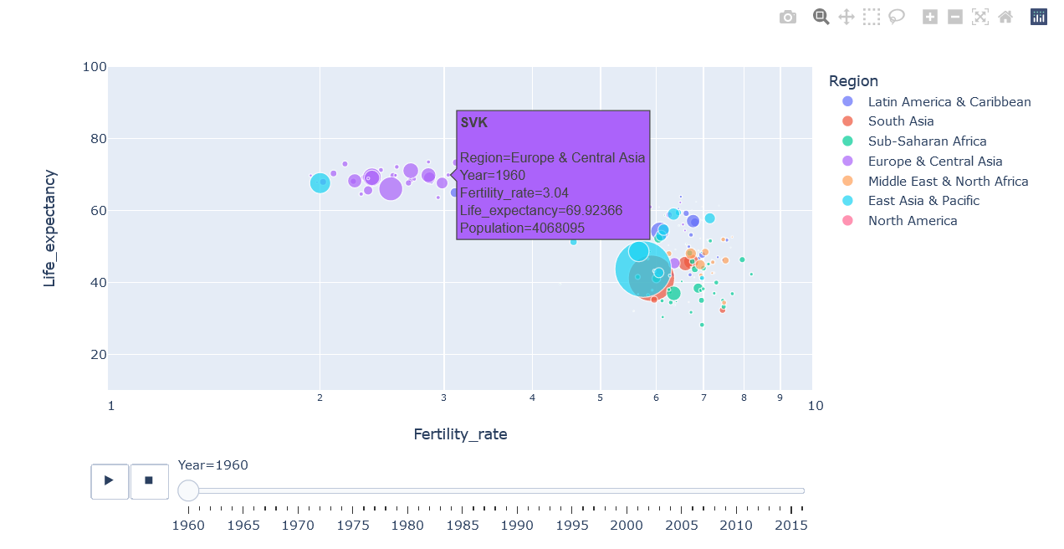
Scatter plot between Fertility_rate and Life_expectancy(Region wise)

Slide 4
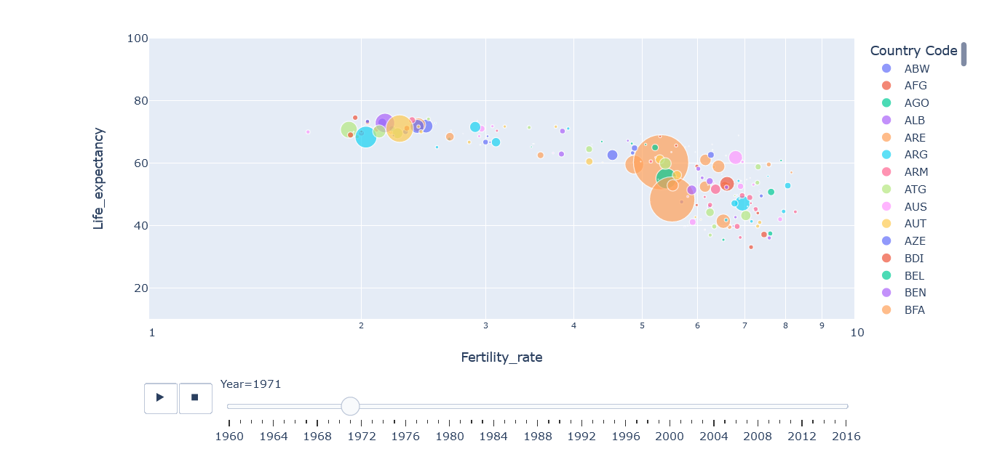
Scatter plot between Fertility_rate and Life_expectancy(Country wise)

Slide 5
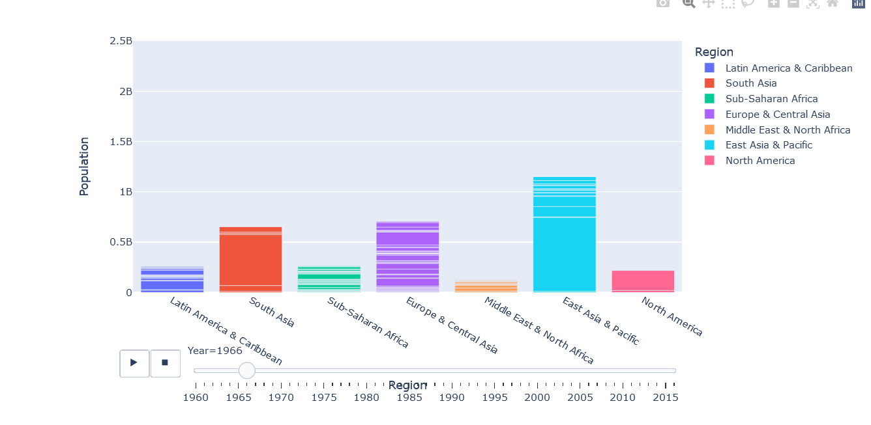
Bar chart of Population

Slide 6
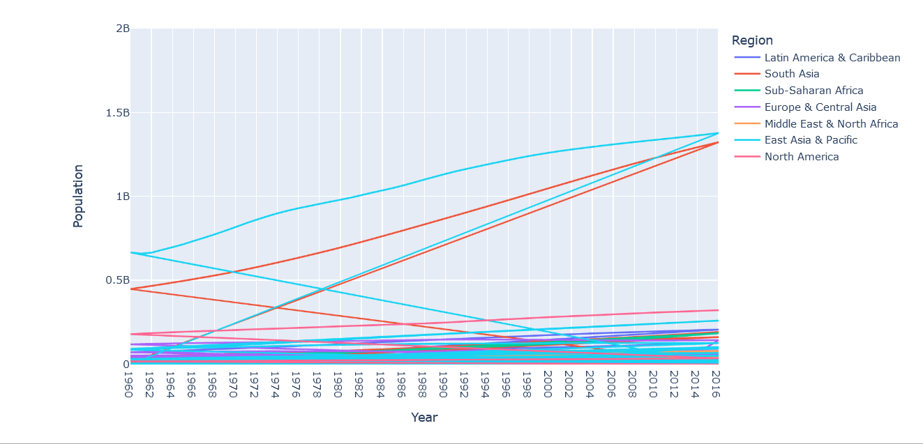
line graph between year and population (region wise)

Slide 7
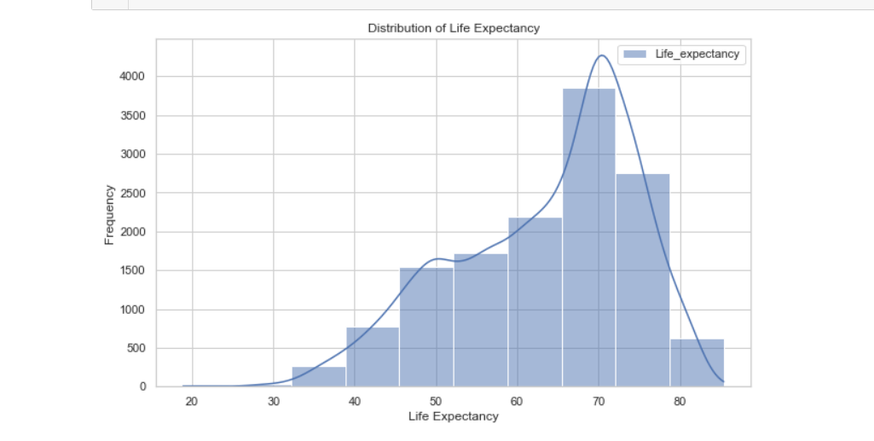
Distribution of Life Expectency

Slide 8
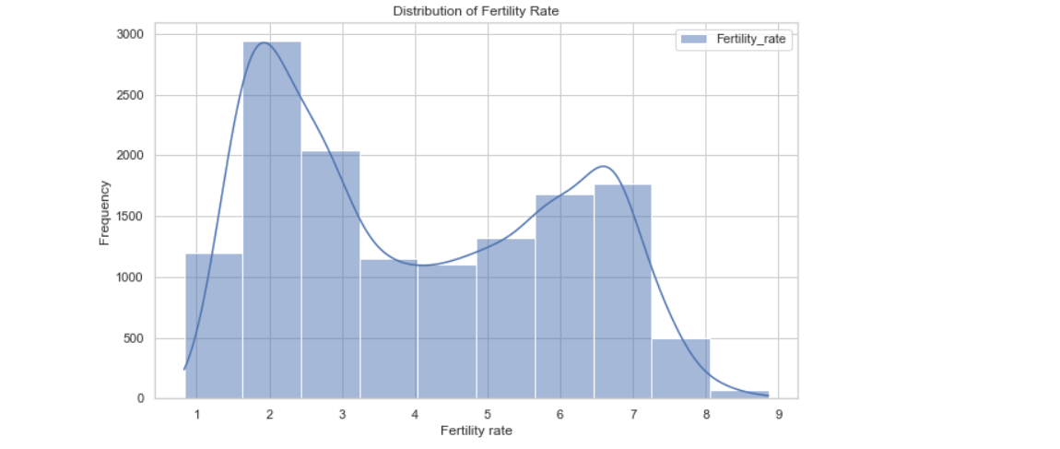
distribution of Fertility Rate

Slide 9
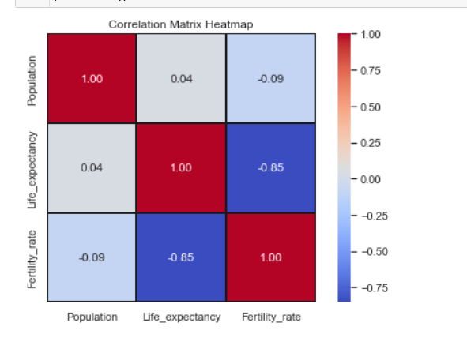
Correlation analysis

